Slide 1
Chapter 7: Deadlocks

Slide 2
内容回顾：同步
临界区问题：
什么是临界区？（一段操作临界资源的代码）
为什么需要临界区？（互斥访问）
各类解决方案：
Peterson （软件）
互斥锁（硬件）
信号量（PV操作）：可以计数
管程：高级语言工具，可以定义变量和对应队列
经典同步问题
有界缓冲问题（典型案例：生产者-消费者）
读者-作者问题：对临界资源的互斥要求不一样
哲学家就餐问题：为多个进程分配多个资源

Slide 3
Chapter 7: Deadlocks(死锁)
The Deadlock Problem
System Model
Deadlock Characterization
Methods for Handling Deadlocks
Deadlock Prevention
Deadlock Avoidance
Deadlock Detection
Recovery from Deadlock
为什么：死锁为何会产生？
是什么：死锁的特点？
怎么办：如何解决死锁？

Slide 4
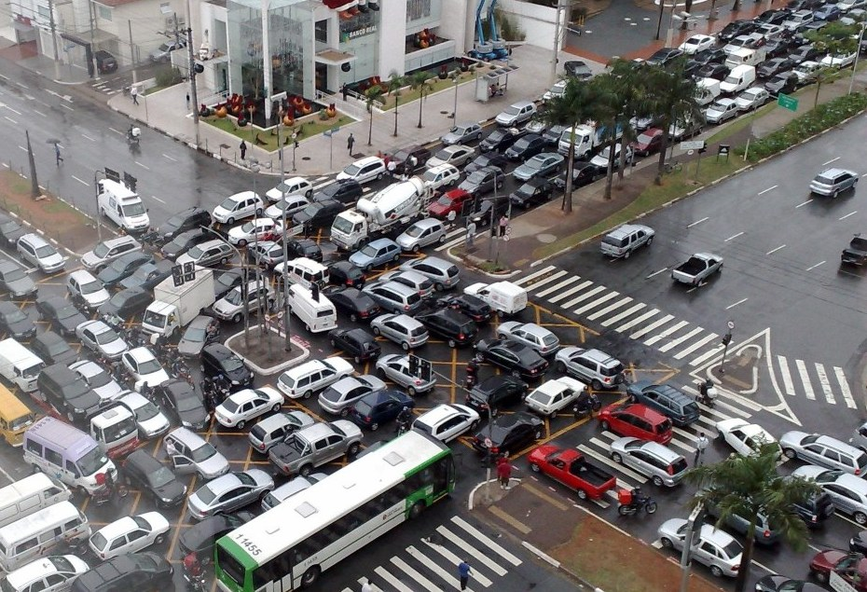
The Deadlock Problem

Slide 5
The Deadlock Problem
A set of blocked processes each holding a resource and waiting to acquire a resource held by another process in the set.
The resources may be either physical resources or logical resources.
physical resources：printer, memory, CPU...
logical resources: semaphore, lock...

Slide 6
The Deadlock Problem
Example
System has 2 disk drives
P₁ and P₂ each hold one disk drive and each needs another one
Example
semaphores A and B, initialized to 1
P₀ P₁
wait (A); wait(B)
wait (B); wait(A)

Slide 7
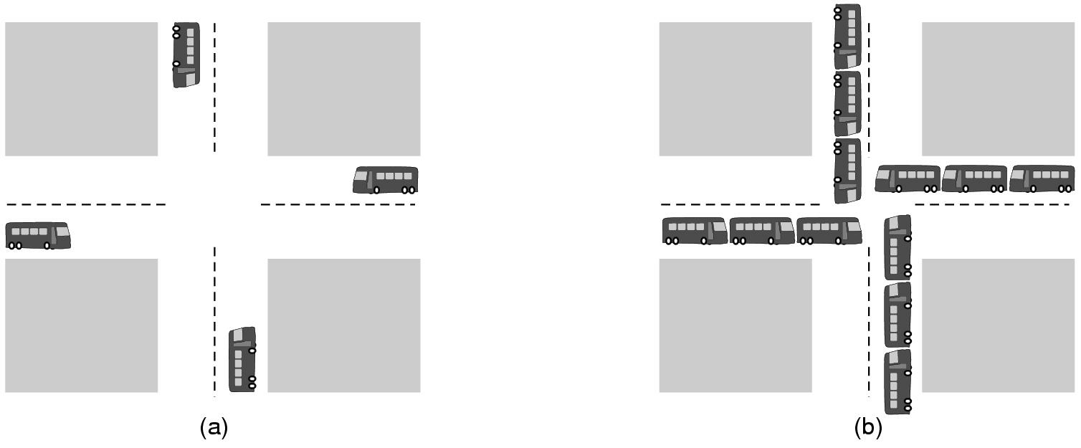
Deadlock Example
(a) A potential deadlock (b) an actual deadlock

Slide 8
Bridge Crossing Example
Traffic only in one direction
Each section of a bridge can be viewed as a resource
If a deadlock occurs, it can be resolved if one car backs up (preempt resources and rollback)（如果发生死锁，可以通过一辆车回退（抢占资源和回滚）来解决）
Several cars may have to be backed up if a deadlock occurs（如果发生死锁，可能需要回退几辆车）
Starvation is possible

Slide 9
Why Deadlock?
Resource competition（资源竞争）
The number of resources is not sufficient for processes requirements（资源不够）
Advance order of Concurrent processes is not appropriate（并发进程的提前顺序不合适）
In a multiprogramming system, it is asynchronous for concurrent processes execution
In some order, each process can complete successfully（按照某种顺序，每个进程都可以成功完成）
In some order, there will be a deadlock （按照某种顺序，可能会导致死锁）

Slide 10
System Model
Resource types R₁, R₂, . . ., R_{m}
CPU cycles, memory space, I/O devices
Each resource type R_{i} has W_{i} instances.
The number of resources requested may not exceed the total number of resources available in the system.
W₁=2
W₂=3
R₁
R₂

Slide 11
How process utilizes a resource?
Each process utilizes a resource as follows:
request (申请)
use (使用)
Release (释放)
The request and release are system calls, such as open() and close() file, and allocate() and free() memory system calls.

Slide 12
Necessary Conditions for Deadlock
Deadlock can arise if four conditions hold simultaneously.
Mutual exclusion(互斥): only one process at a time can use a resource
Hold and wait(占有并等待): a process holding at least one resource is waiting to acquire additional resources held by other processes
No preemption(非抢占): a resource can be released only voluntarily by the process holding it, after that process has completed its task

Slide 13
Necessary Conditions for Deadlock(Cont)
Circular wait(循环等待 ): there exists a set {P₀, P₁, …, P_{n}} of waiting processes such that P₀ is waiting for a resource that is held by P₁, P₁ is waiting for a resource that is held by P₂, …, P_{n–1} is waiting for a resource that is held by P_{n}, and P_{n} is waiting for a resource that is held by P₀.
Process A
Resource A
Resource B
Process B

Slide 14
Resource-Allocation Graph(资源分配图)
A set of vertices V and a set of edges E.
V is partitioned into two types:
P = {P₁, P₂, …, P_{n}}, the set consisting of all the processes in the system
R = {R₁, R₂, …, R_{m}}, the set consisting of all resource types in the system
request edge(申请边) – directed edge P₁ → R_{j}
assignment edge(分配边) – directed edge R_{j} → P_{i}

Slide 15
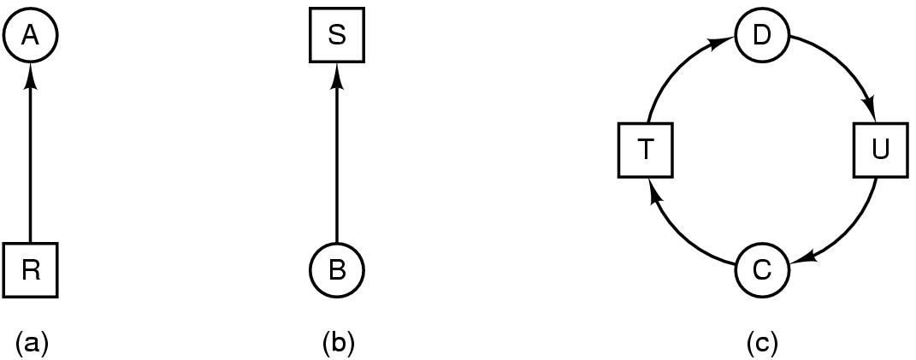
Resource-Allocation Graph
Resource R assigned to process A
Process B is requesting/waiting for resource S
Process C and D are in deadlock over resources T and U

Slide 16
Resource-Allocation Graph (Cont.)
Resource Type with 4 instances
P_{i} requests instance of R_{j}
P_{i} is holding an instance of R_{j}
P_{i}
R_{j}
P_{i}
R_{j}

Slide 17
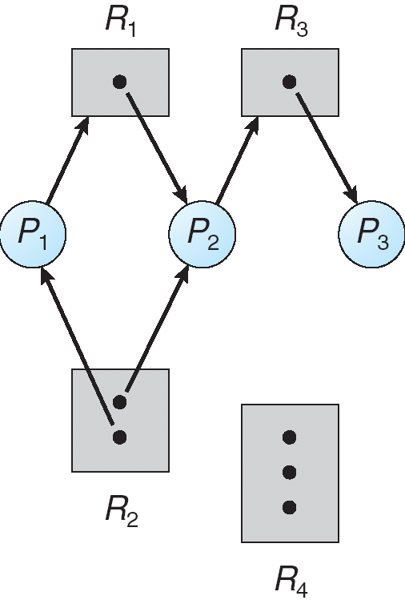
Example of a Resource Allocation Graph

Slide 18
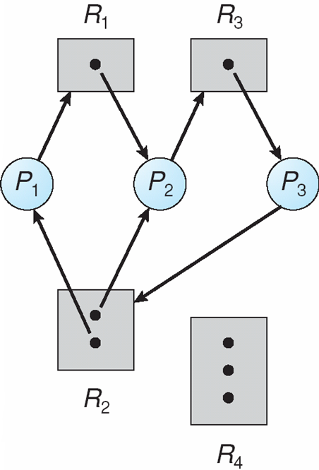
Resource Allocation Graph With A Deadlock

Slide 19

Graph With A Cycle But No Deadlock

Slide 20
Basic Facts
If graph contains no cycles ⇒ no deadlock
If graph contains a cycle ⇒
if only one instance per resource type, then deadlock
if several instances per resource type, possibility of deadlock

Slide 21
例题
以下关于产生死锁的四个必要条件的叙述不正确的是（ ）
A 系统中只要同时具备了产生死锁的4个必要条件，就一定会发生死锁
B 产生死锁的四个必要条件之间不是完全独立的，但也不是等价的
C 解决死锁问题可以从产生死锁的四个必要条件出发
D 一旦出现死锁现象，处于死锁状态的进程一定同时具备产生死锁的四个必要条件
答案：A

Slide 22
例题
在（ ）情况下系统出现了死锁
A 计算机系统发生了重大故障
B 若进程因竞争资源而无休止地相互等待对方释放已占有的资源
C 系统中的资源总量远远小于进程数或多个进程同时申请的资源量超过系统可分配资源量
D 有多个阻塞的进程同时存在
答案：B

Slide 23
Chapter 7: Deadlocks(死锁)
The Deadlock Problem
System Model
Deadlock Characterization
Methods for Handling Deadlocks
Deadlock Prevention
Deadlock Avoidance
Deadlock Detection
Recovery from Deadlock
怎么办：如何解决死锁？

Slide 24
Methods for Handling Deadlocks
Ensure that the system will never enter a deadlock state
Deadlock prevention (死锁预防)
Deadlock avoidance (死锁避免)
Allow the system to enter a deadlock state and then recover
Deadlock detection and recovery (死锁检测和恢复)
Ignore the problem and pretend that deadlocks never occur in the system; used by most operating systems, including UNIX
Ostrich policy

Slide 25
Deadlock Prevention (死锁预防)
Restrain the ways request can be made, so that at least one of the necessary conditions for deadlock can not occur.(限制可以发出请求的方式，使至少一个死锁的必要条件不会发生。)
Mutual Exclusion(打破互斥)
not required for sharable resources; must hold for nonsharable resources.
Notes:
抑制死锁发生的必要条件

Slide 26
Deadlock Prevention
Hold and Wait（打破持有并等待） – must guarantee that whenever a process requests a resource, it does not hold any other resources
Require process to request and be allocated all its resources before it begins execution (执行前申请所有资源)
or allow process to request resources only when the process has none (只有不持有资源时才能申请)
Drawback:
Low resource utilization; starvation possible

Slide 27


Dining Philosophers
5 philosophers sitting around a round table
1 chopstick in between each pair of philosophers
5 chopsticks total
Each philosopher needs two chopsticks to eat
How to prevent deadlock
solution:
1. 只有一个哲学家的两根筷子都可用时，
他才能拿起他们（执行前申请全部资源）
2. 如果有且仅有一根筷子，那么必须先放
下这根筷子才能申请全部两根筷子
（不持有资源时才能申请）

Slide 28
Deadlock Prevention (Cont.)
No Preemption –（打破非抢占）
If a process that is holding some resources requests another resource that cannot be immediately allocated to it, then all resources currently being held are released(如果一个进程新的资源申请没有满足，它要释放占有的所有资源)
Preempted resources are added to the list of resources for which the process is waiting(这些被抢占的资源放入进程等待资源列表中,)
Process will be restarted only when it can regain its old resources, as well as the new ones that it is requesting(这个进程只有能够同时得到原有的资源和申请的新资源时,才能重新开始)
Notes:
规定:
如果一个进程新的资源申请没有满足，它要释放占有的所有资源
这些被抢占的资源放入进程等待资源列表中,
这个进程只有能够重新得到原有的资源，并且它所申请的新资源也可得到时,才能重新开始

Slide 29
Deadlock Prevention (Cont.)
Allow Preemption!（允许抢占）
Can preempt CPU by
saving its state to thread control block and resuming later（将其状态保存到线程控制块并稍后恢复）
Can preempt memory by
swapping memory out to disk and loading it back later（将内存交换到磁盘，稍后再将其加载回来）
Can we preempt the holding of a lock?

Slide 30
Deadlock Prevention (Cont.)
Some resource cannot be preempted
Consider a process given the printer
halfway through its job
now forcibly take away printer
!!??

Slide 31
Deadlock Prevention (Cont.)
Circular Wait （打破循环等待）
impose a total ordering of all resource types, and require that each process requests resources in an increasing order of enumeration（强加所有资源类型的总顺序，并要求每个进程以递增的顺序请求资源）

Slide 32
Deadlock Prevention (Cont.)
我们定义了一个函数F: R→N，其中N是自然数的集合。例如：
F(磁带驱动器)=1
F(磁盘驱动器)=5
F(打印机)=12
我们采用以下协议来预防死锁：每个进程只能按照递增迅速申请资源。即一个进程开始可申请任何数量的资源类型Ri的实例。之后，当且仅当F(Rj)>F(Ri)时，该进程才可以申请资源类型Rj的实例。
也就是说，当一个进程申请资源类型Rj时，需要先释放所有满足F(Ri)>=F(Rj)的Ri。

Slide 33
Deadlock Prevention (Cont.)
进程P
P1
P2
P3
......
Pi-1
Pi
资源R
R1
R2
R3
......
Rn-1
Rn
F(R)
1
2
3
......
n-1
n

Slide 34
Deadlock Prevention
Possible side effects（副作用）:
Low device utilization （设备利用率低）
Reduced system throughput（系统吞吐量低）

Slide 35
例题
环路条件是死锁发生的（ ）
A 与死锁无关
B 必要条件
C 充分条件
D 充要条件
答案：B

Slide 36
例题
资源静态分配可以预防死锁的发生，这是由于它使死锁中四个条件中的（ ）不成立
A 互斥条件
B 请求和保持条件
C 非抢占条件
D 环路等待条件
答案：B

Slide 37
例题
有序分配破坏的是死锁必要条件中的（ ）
A 互斥条件
B 请求和保持条件
C 非抢占条件
D 环路等待条件
答案：D

Slide 38
死锁预防 vs. 死锁避免
死锁预防：通过限制如何申请资源来预防死锁
死锁避免：动态地检查资源分配状态，以便确保循环等待条件不能成立。
系统在进行资源分配之前，先计算资源分配的安全性:
安全:分配资源给进程
不安全:进程等待
安全状态：如果系统能按照一定顺序为每个进程分配资源（不超过它的最大需求），仍然避免死锁，那么系统的状态就是安全的。
只有存在一个安全序列，系统才处于安全状态
不安全状态：如果没有这样的序列存在，那么系统状态就是非安全的

Slide 39
Safe State
System is in safe state if there exists a sequence <P₁, P₂, …, P_{n}> of ALL the processes in the systems such that for each P_{i}, the resources that P_{i} can still request can be satisfied by currently available resources + resources held by all the P_{j}, with j < I
（如果系统中存在一个序列<P1, P2，…，Pn>，使得对于每个Pi， Pi仍然可以请求的资源可以由当前可用资源+所有Pj持有的资源来满足，且j < i，则系统处于安全状态）

Slide 40
Safe State
That is:
If P_{i} resource needs are not immediately available, then P_{i} can wait until all P_{j} have finished（如果Pi资源需求不能立即可用，则Pi可以等到所有Pj都完成）
When P_{j} is finished, P_{i} can obtain needed resources, execute, return allocated resources, and terminate（当Pj完成后，Pi可以获取所需的资源，执行，返回分配的资源，并终止）
When P_{i} terminates, P_{i +1} can obtain its needed resources, and so on （当Pi终止时，Pi+1可以获得所需的资源，以此类推）

Slide 41
example
processes:P₁、P₂ and P_{3.} System owned:12 tapes. Snapshot at T₀ :
process max allocated need available
P₁ 10 5 5 3
P₂ 4 2 2
P₃ 9 2 7
T_{0 时刻安全吗？}
P₂
process max allocated need available
P₁ 10 5 5 3-2=1
P₂ 4 2+2=4 2-2=0
P₃ 9 2 7

Slide 42
example
processes:P₁、P₂ and P_{3.} System owned:12 tapes. Snapshot at T₀ :
P₂ -> P₁
process max allocated need available
P₁ 10 5 5 1+4=5
P₂ 0 0 0
P₃ 9 2 7
process max allocated need available
P₁ 10 5+5=10 5-5=0 5-5=0
P₂ 0 0 0
P₃ 9 2 7

Slide 43
example
processes:P₁、P₂ and P_{3.} System owned:12 tapes. Snapshot at T₀ :
P₂ -> P₁ -> P₃
process max allocated need available
P₁ 10 0 0 0+10=10
P₂ 0 0 0
P₃ 9 2 7
So, system is safe at T_{0.}

Slide 44
System goes from a safe state to an unsafe state
Suppose that, at T_{0,} P₃ requests a tape and is allocated one tape. Then system goes from T₀ to T_{1.}
Process max allocated need available
P₁ 10 5 5
P₂ 4 2 2 2
P₃ 9 3 6
At T_{1,} we can not find a sequence satisfying safety condition, so, it is unsafe.
Therefore, when P₃ requests a tape at T_{0,} we must make it wait to avoid deadlock.

Slide 45
Basic Facts
If a system is in safe state ⇒ no deadlocks
（如果系统处于安全状态⇒没有死锁）
If a system is in unsafe state ⇒ possibility of deadlock
（如果系统处于不安全状态⇒有死锁的可能性）
Avoidance ⇒ ensure that a system will never enter an unsafe state.（死锁避免⇒ 确保系统永远不会进入不安全状态。 ）

Slide 46
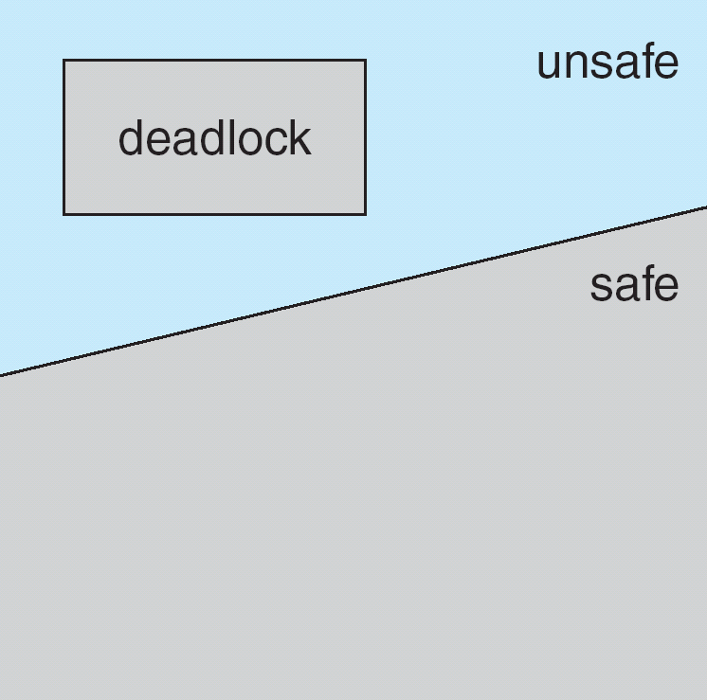
Safe, Unsafe , Deadlock State

Slide 47
Avoidance algorithms
Single instance of a resource type
Use a resource-allocation graph（资源分配图）
Multiple instances of a resource type
Use the banker’s algorithm (银行家算法)

Slide 48
Resource-Allocation Graph Scheme
Claim edge(需求边) P_{i} → R_{j} indicated that process P_{j} may request resource R_{j}; represented by a dashed line
Claim edge converts to request edge(申请边) when a process requests a resource
Request edge converted to an assignment edge(分配边) when the resource is allocated to the process
When a resource is released by a process, assignment edge reconverts to a claim edge（当资源被进程释放时，分配边重新转换为需求边）
Resources must be claimed a priori in the system（资源必须在系统中预先声明）

Slide 49
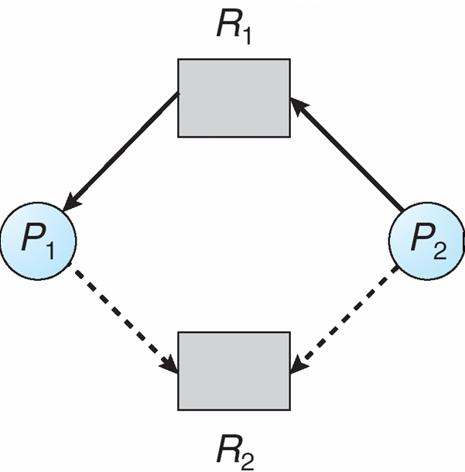
Resource-Allocation Graph

Slide 50
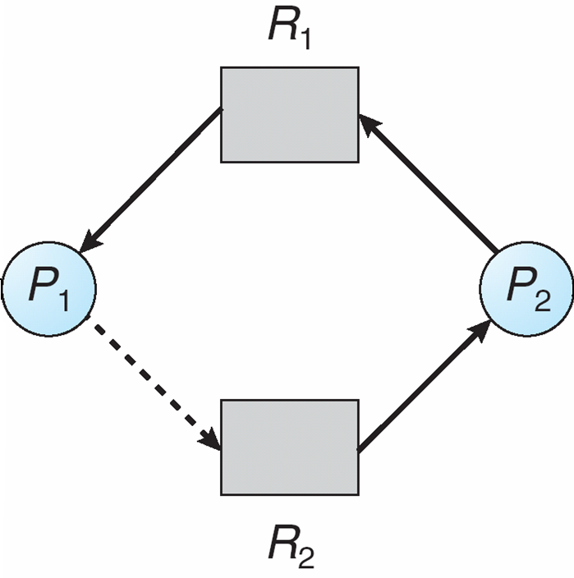
Unsafe State In Resource-Allocation Graph

Slide 51
Resource-Allocation Graph Algorithm
Suppose that process P_{i} requests a resource R_{j}
The request can be granted only if converting the request edge to an assignment edge does not result in the formation of a cycle in the resource allocation graph（图中是否有环）
如何检测环？
深度遍历

Slide 52
Banker’s Algorithm
Multiple instances（针对多实例的情况）
Each process must claim the maximum number of each resource type it may need（每个进程必须声明它可能需要的每种资源类型的最大数量）
When a process requests a resource it may have to wait （当进程请求资源时，它可能需要等待）
When a process gets all its resources it must return them in a finite amount of time（当一个进程获得它所有的资源时，它必须在有限的时间内返回它们）
Notes:
要求每个进程运行前先声明对每种资源的最大需求数

Slide 53
Data Structures for the Banker’s Algorithm
Let n = number of processes,
m = number of resources types.
Available: Vector of length m. If available [j] = k, there are k instances of resource type R_{j} available
Max: n x m matrix. If Max [i,j] = k, then process P_{i} may request at most k instances of resource type R_{j}
Allocation: n x m matrix. If Allocation[i,j] = k then P_{i} is currently allocated k instances of R_{j}
Need: n x m matrix. If Need[i,j] = k, then P_{i} may need k more instances of R_{j} to complete its task
Need [i,j] = Max[i,j] – Allocation [i,j]

Slide 54
Safety Algorithm
1. Let Work and Finish be vectors of length m and n, respectively. Initialize:
Work = Available
Finish [i] = false for i = 0, 1, …, n- 1
2. Find an i such that both:
(a) Finish [i] = false
(b) Need_{i} ≤ Work
If no such i exists, go to step 4
3. Work = Work + Allocation_{i} Finish[i] = true go to step 2
4. If Finish [i] == true for all i, then the system is in a safe state

Slide 55
Resource-Request Algorithm for Process P_{i}
Request_{i} = request vector for process P_{i}. If Request_{i} [j] = k then process P_{i} wants k instances of resource type R_{j}
1. If Request_{i} ≤ Need_{i} go to step 2. Otherwise, raise error condition, since process has exceeded its maximum claim
2. If Request_{i} ≤ Available, go to step 3. Otherwise P_{i} must wait, since resources are not available
3. Pretend to allocate requested resources to P_{i} by modifying the state as follows:
Available = Available – Request;
Allocation_{i} = Allocation_{i} + Request_{i};
Need_{i} = Need_{i} – Request_{i};
If safe ⇒ the resources are allocated to Pi
If unsafe ⇒ Pi must wait, and the old resource-allocation state is restored

Slide 56
Example of Banker’s Algorithm
5 processes P₀ through P₄;
3 resource types:
A (10 instances), B (5instances), and C (7 instances)
Snapshot at time T₀:
Allocation Max Available
A B C A B C A B C
P₀ 0 1 0 7 5 3 3 3 2
P₁ 2 0 0 3 2 2
P₂ 3 0 2 9 0 2
P₃ 2 1 1 2 2 2
P₄ 0 0 2 4 3 3

Slide 57
Example (Cont.)
The content of the matrix Need is defined to be
Max – Allocation
Need
A B C
P₀ 7 4 3
P₁ 1 2 2
P₂ 6 0 0
P₃ 0 1 1
P₄ 4 3 1

Slide 58
Example (Cont.)
To find a safe sequence using safety algorithm
Work[]=available=(3,3,2)
Finish[i]=false (i=0..4)
Work need allocation finish
P1 3 3 2 1 2 2 2 0 0
P3 5 3 2 0 1 1 2 1 1
P4 7 4 3 4 3 1 0 0 2
P2 7 4 5 6 0 0 3 0 2
P0 10 4 7 7 4 3 0 1 0
The system is in a safe state since the sequence < P₁, P₃, P₄, P₂, P₀> satisfies safety criteria
T
T
T
T
T

Slide 59
例题
【解答题】系统的资源数量为：（10，5，7）。经过一段时间的分配后，资源分配与占用情况见下表所示。
进程 | MAX A B C | Allocation A B C | Need A B C | Available A B C
P0 | 7 5 3 | 0 1 0 | 7 4 3 | 3 3 2
P1 | 3 2 2 | 2 0 0 | 1 2 2
P2 | 9 0 2 | 3 0 2 | 6 0 0
P3 | 2 2 2 | 2 1 1 | 0 1 1
P4 | 4 3 3 | 0 0 2 | 4 3 1
以下请求是否能得到满足：
1） Request 1（1,0,2）
2） Request 4(3,3,0)
3) Request 3（0,1,0)

Slide 60
Methods for Handling Deadlocks
Ensure that the system will never enter a deadlock state
Deadlock prevention (死锁预防)
Deadlock avoidance (死锁避免)
Allow the system to enter a deadlock state and then recover
Deadlock detection and recovery (死锁检测和恢复)

Slide 61
Deadlock Detection(死锁检测)
Allow system to enter deadlock state
Detection algorithm
Recovery scheme

Slide 62
Single Instance of Each Resource Type
Maintain wait-for graph
Nodes are processes
P_{i} → P_{j} if P_{i} is waiting for P_{j}
Periodically invoke an algorithm that searches for a cycle in the graph. If there is a cycle, there exists a deadlock（定期调用在图中搜索循环的算法。如果存在循环，则存在死锁）
An algorithm to detect a cycle in a graph requires an order of n² operations, where n is the number of vertices in the graph（在图中检测循环的算法需要进行n^2次操作，其中n是图中顶点的数量）

Slide 63
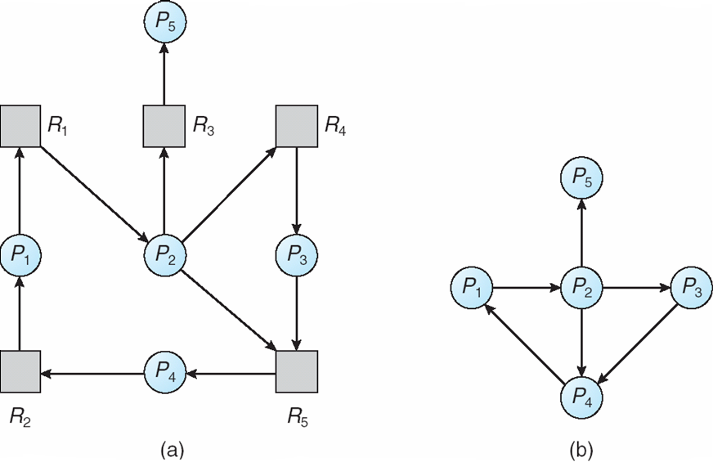
Resource-Allocation Graph and Wait-for Graph
Resource-Allocation Graph
Corresponding wait-for graph

Slide 64
Several Instances of a Resource Type
Available: A vector of length m indicates the number of available resources of each type.
Allocation: An n x m matrix defines the number of resources of each type currently allocated to each process.
Request: An n x m matrix indicates the current request of each process. If Request [i_{j}] = k, then process P_{i} is requesting k more instances of resource type. R_{j}.
Notes:
银行家：Max，Allocation，Need

Slide 65
Detection Algorithm
1. Let Work and Finish be vectors of length m and n, respectively Initialize:
(a) Work = Available
(b) For i = 1,2, …, n, if Allocation_{i} ≠ 0, then Finish[i] = false;otherwise, Finish[i] = true
2. Find an index i such that both:
(a) Finish[i] == false
(b) Request_{i} ≤ Work
If no such i exists, go to step 4
（还有资源未释放）
（需求能够被满足）

Slide 66
Detection Algorithm (Cont.)
3. Work = Work + Allocation_{i} Finish[i] = true go to step 2
4. If Finish[i] == false, for some i, 1 ≤ i ≤ n, then the system is in deadlock state. Moreover, if Finish[i] == false, then P_{i} is deadlocked
（释放已有资源）
（认为该进程可以执行完毕）
Algorithm requires an order of O(m x n²⁾ operations to detect whether the system is in deadlocked state

Slide 67
与银行家算法对比
死锁检测算法：
银行家算法：
1. (a) Work = Available
(b)For i = 1,2, …, n, if Allocation_{i} ≠ 0, then Finish[i] = false;otherwise, Finish[i] = true
2. Find an index i such that both:
(a) Finish[i] == false
(b) Request_{i} ≤ Work
If no such i exists, go to step 4
1. (a) Work = Available
(b)Finish [i] = false for i = 0, 1, …, n- 1
2. Find an i such that both:
(a) Finish [i] == false
(b) Need_{i} ≤ Work
If no such i exists, go to step 4

Slide 68
与银行家算法对比
死锁检测算法：
银行家算法：
3. Work = Work + Allocation_{i} Finish[i] = true go to step 2
4. If Finish[i] == false, for some i, 1 ≤ i ≤ n, then the system is in deadlock state. Moreover, if Finish[i] == false, then P_{i} is deadlocked
3. Work = Work + Allocation_{i} Finish[i] = true go to step 2
4. If Finish [i] == true for all i, then the system is in a safe state

Slide 69
Example of Detection Algorithm
Five processes P₀ through P₄; three resource types A (7 instances), B (2 instances), and C (6 instances)
Snapshot at time T₀:
Allocation Request Available
A B C A B C A B C
P₀ 0 1 0 0 0 0 0 0 0
P₁ 2 0 0 2 0 2
P₂ 3 0 3 0 0 0
P₃ 2 1 1 1 0 0
P₄ 0 0 2 0 0 2
Sequence <P₀, P₂, P₃, P₁, P₄> will result in Finish[i] = true for all i

Slide 70
Example (Cont.)
P₂ requests an additional instance of type C
Allocation Request Available
A B C A B C A B C
P₀ 0 1 0 0 0 0 0 0 0
P₁ 2 0 0 2 0 1
P₂ 3 0 3 0 0 1
P₃ 2 1 1 1 0 0
P₄ 0 0 2 0 0 2
State of system?
Can reclaim resources held by process P₀, but insufficient resources to fulfill other processes requests
Deadlock exists, consisting of processes P₁, P₂, P₃, and P₄

Slide 71
Detection-Algorithm Usage
When, and how often, to invoke depends on（调用的时间和频率取决于）:
How often a deadlock is likely to occur?（死锁发生的频率有多高?）
How many processes will need to be rolled back?（需要回滚多少进程？）
one for each disjoint cycle（每个不相交的循环一个）

Slide 72
Detection-Algorithm Usage
We can invoke deadlock detection algorithm every time a resource request cannot be granted immediately.（在每次不能立即授予资源请求时调用死锁检测算法）
Lead to a considerable overhead in computation time.
A less expensive alternative is to invoke the algorithm at less frequent intervals.（更简单的方法：）
Once per hour（每小时）
Whenever CPU utilization drops below 40%.（CPU利用率低于40%）
Notes:
72

Slide 73
Recovery from Deadlock: Process Termination
Abort all deadlocked processes（中止所有死锁进程）
Abort one process at a time until the deadlock cycle is eliminated（每次中止一个进程，直到死锁周期消除）
In which order should we choose to abort?（按什么顺序中止）
Priority of the process
How long process has computed, and how much longer to completion
Resources the process has used
Resources process needs to complete
How many processes will need to be terminated
Is process interactive or batch?

Slide 74
Recovery from Deadlock: Resource Preemption
Selecting a victim – minimize cost
Rollback – return to some safe state, restart process for that state（回滚-返回到某个安全状态，重新启动该状态的进程）
Starvation – same process may always be picked as victim, include number of rollback in cost factor（饥饿-同一进程可能总是被选为受害者）

Slide 75
Chapter 7: Deadlocks(死锁)
The Deadlock Problem
System Model
Deadlock Characterization
Methods for Handling Deadlocks
Deadlock Prevention
Deadlock Avoidance
Deadlock Detection
Recovery from Deadlock
为什么：死锁为什么产生
是什么：死锁的特点？
四大必要条件：互斥、占有并等待、非抢占、循环等待
怎么办：如何解决死锁？
死锁预防：破坏四个必要条件
死锁避免：
单实例：检测环
多实例：银行家算法
死锁检测：
单实例：检测环
多实例：死锁检测算法
死锁恢复：牺牲某个/多个进程

Slide 76
例题
死锁与安全状态的关系是（ ）
A 死锁状态一定是不安全状态
B 不安全状态就是死锁状态
C 安全状态有可能成为死锁状态
D 死锁状态有可能是安全状态
答案：A

Slide 77
例题
设系统中有N（N>2）个进程，则系统中最不可能的是有（ ）个进程处于死锁状态
A 0
B 1
C 2
D M（2<M<=N）
答案：B

Slide 78
例题
假设现在有p个进程，每个进程最多需要m个资源，请问资源个数为多少个时，死锁一定不会发生？
答案：如果一个进程有m个资源，它就能够结束，不会使自己陷入死锁中。因此，最差的情况是每个进程有m-1个资源并且需要另一个资源。如果留一下有一个资源可用，那么其中某一个进程就能够结束并释放它所有的资源，使其他进程也能结束。所以避免死锁的条件是：r>=p(m-1)+1

Slide 79
例题
一台计算机有6台磁带机，由n个进程竞争使用，每个进程可能需要两台磁带机，那么n是多少时，系统才没有死锁的危险？
答案：
对于3个进程，每个进程能够有两个驱动器。
对于4个进程，驱动器可以按照（2,2,1,1）分配
对于5个进程，可以按照（2,1,1,1,1）的方法进行分发
对于6个进程，如果每个进程都有1个磁带机，，同时需要另一个磁带机，产生死锁。
因此，n<6时系统没有死锁危险

Slide 80
例题
某系统中有3个并发进程，都需要同类资源4个，试问该系统不会发生死锁的最少资源数量是
A 9
B 10
C 11
D 12
答案：B
3个进程*（4个资源-1）+1=3*3+1=10

Slide 81
例题
在下列选项中，属于检测死锁的方法是（ ）。
A.银行家算法 B.消进程法
C.资源静态分配法 D.资源分配图简化法
答案：D

Slide 82
例题
下面列出的选项中，属于可抢占性资源的有（ ）
A.CPU B.内存
C.磁盘 D.磁带机
答案： ABC

Slide 83
例题
下面列出的选项中，属于可抢占性资源的有（ ）
A.CPU B.内存
C.磁盘 D.磁带机
答案： ABC

Slide 84
End of Chapter 7

